Slide 1
Online Adaptive Local Interpretable Tree Ensembles for Time Series Forecasting
Dr. Amal Saadallah

Slide 2
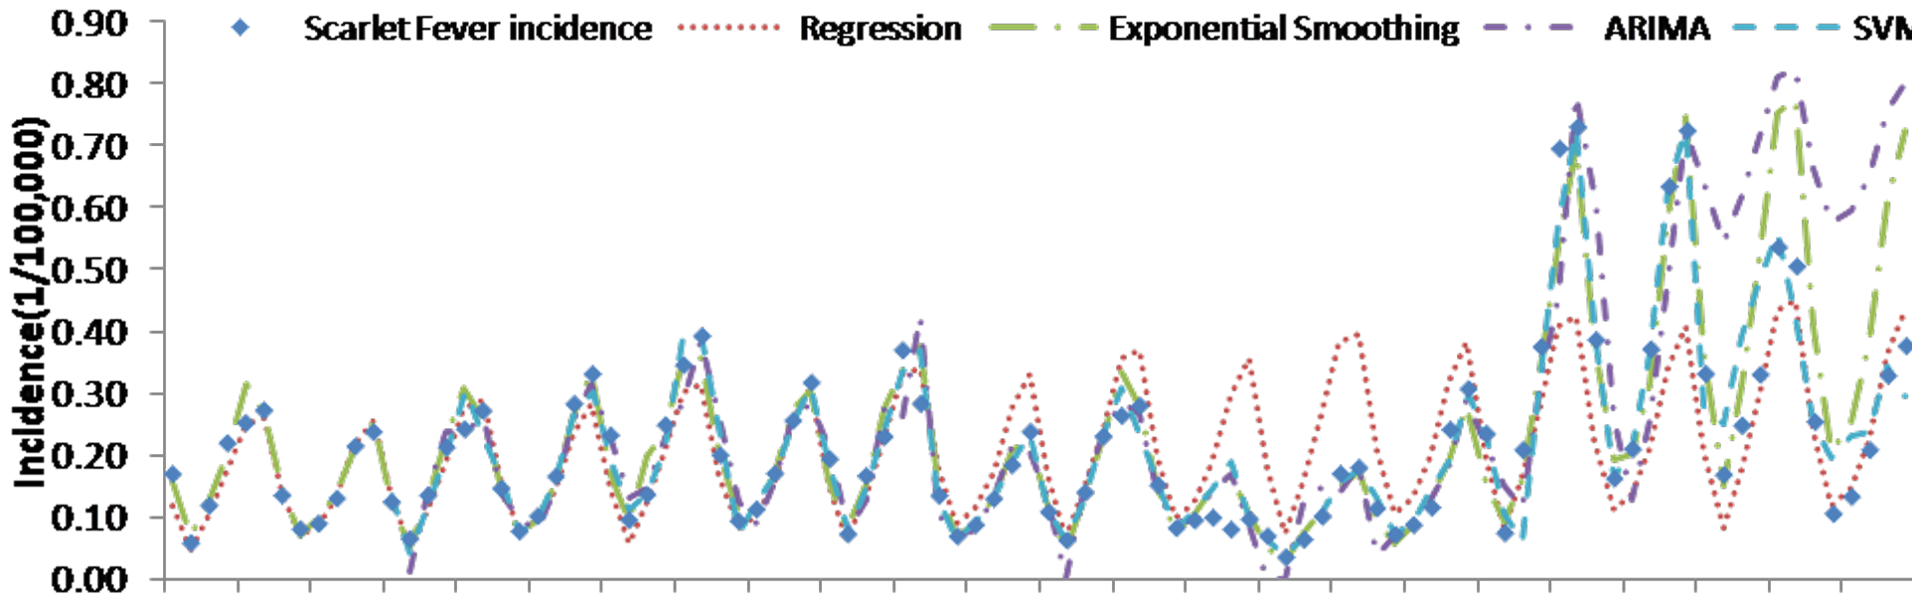
Motivation
Due to the time-evolving and dynamic nature of time series, forecasting models do not hold the same performance level over time.
Notes:
Color Codes hier ergänzen

Slide 3
Motivation
Due to the time-evolving and dynamic nature of time series, forecasting models do not hold the same performance level over time.
Combining many models using an ensemble technique can be a solution to cover the weakness of some models in some time intervals or points.
Notes:
Color Codes hier ergänzen

Slide 4
Motivation
Due to the time-evolving and dynamic nature of time series, forecasting models do not hold the same performance level over time.
Combining many models using an ensemble technique can be a solution to cover the weakness of some models in some time intervals or points.
Ensemble model :
Adaptive to cope with the dynamics of time series.
Notes:
Color Codes hier ergänzen

Slide 5
Motivation
Due to the time-evolving and dynamic nature of time series, forecasting models do not hold the same performance level over time.
Combining many models using an ensemble technique can be a solution to cover the weakness of some models in some time intervals or points.
Ensemble model :
Adaptive to cope with the dynamics of time series.
Explainable to increase trustworthiness in decision-making based on the results of this model.
Notes:
Color Codes hier ergänzen

Slide 6
Methodology
Online Ensemble Construction Stages:
Ensemble Base Models Generation
Ensemble Pruning
Ensemble Aggregation
Ensemble Adaptation
Notes:
Color Codes hier ergänzen

Slide 7
Methodology
Ensemble Base Models Generation
Selection of decision trees as the ensemble base models.
Shape-based time series subsequences clustering to specialize distinct trees across different regions in the time series.
In each group of patterns, generate various trees by varying the input lagged values and the maximum depth.
Notes:
Color Codes hier ergänzen

Slide 8
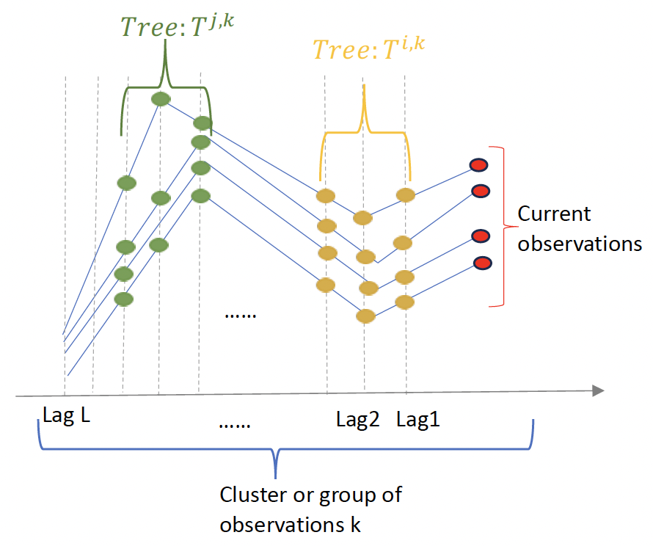
Methodology
Ensemble Base Models Generation
Selection of decision trees as the ensemble base models.
Shape-based time series subsequences clustering to specialize distinct trees across different regions in the time series.
In each group of patterns, generate various trees by varying the input lagged values and the maximum depth.
Figure1: Single decision trees generation process
Notes:
Color Codes hier ergänzen

Slide 9
Methodology
Ensemble Pruning
Computing the distance between the current pattern and the clustered subsequences
Notes:
Color Codes hier ergänzen

Slide 10
Methodology
Ensemble Pruning
Computing the distance between the current pattern and the clustered subsequences
The set of trees corresponding to:
are selected to compose the ensemble.
Notes:
Color Codes hier ergänzen

Slide 11
Methodology
Ensemble Aggregation
Initial Weighting:
Notes:
Color Codes hier ergänzen

Slide 12
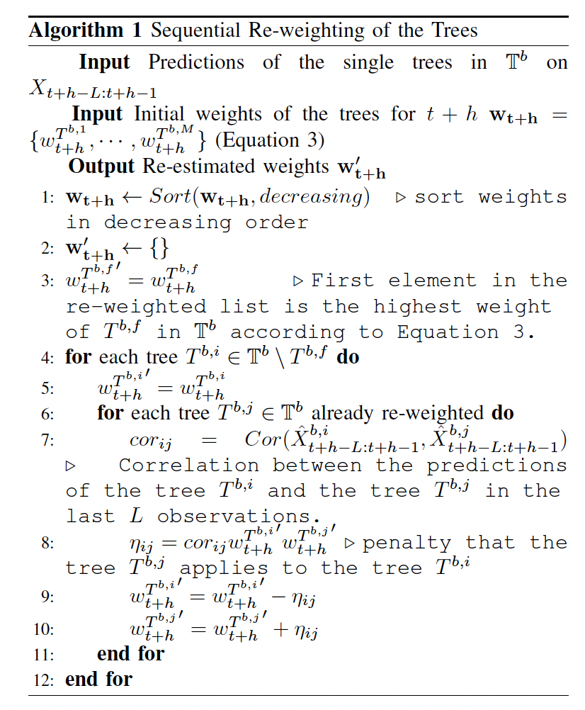
Methodology
Ensemble Aggregation
Initial Weighting:
Sequential Re-weighting:
Notes:
Color Codes hier ergänzen

Slide 13
Methodology
Ensemble Adaptation
Detecting concept drift occurrence in the time series by monitoring the deviation in the mean of the time series over time using the Hoeffding bound.
When a concept drift is detected, an alarm is triggered to update the trees’ generation and training by sliding the time series to include the new observations until the time instant when the drift has been detected.
The trees are updated to account for these changes, and the ensemble pruning is also updated to identify the most appropriate trees to handle these new patterns.
Notes:
Color Codes hier ergänzen

Slide 14
Experiments
Experimental Set-up
We utilize 1000 univariate datasets from various application domains.
The number of lags L, i.e., the length of the clustered subsequences, is set to 8.
To generate and train the trees, we randomly sample s = 5 from the 8 lagged features. This results in 56 possible lag combinations.
We vary the maximum depth of the trees d_max in {4, 8, 12}. This results in a total number of M = 168 trees trained on each cluster of observations.
Notes:
Color Codes hier ergänzen

Slide 15
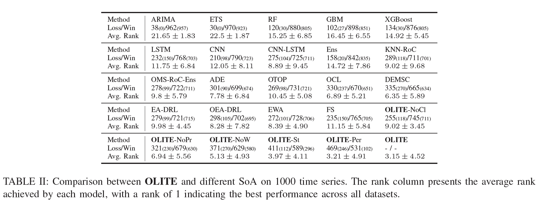
Experiments
Results
OLITE: Online adaptive Local Interpretable Tree Ensembles for time series forecasting
Notes:
Color Codes hier ergänzen

Slide 16
Experiments
Results
Notes:
Color Codes hier ergänzen

Slide 17
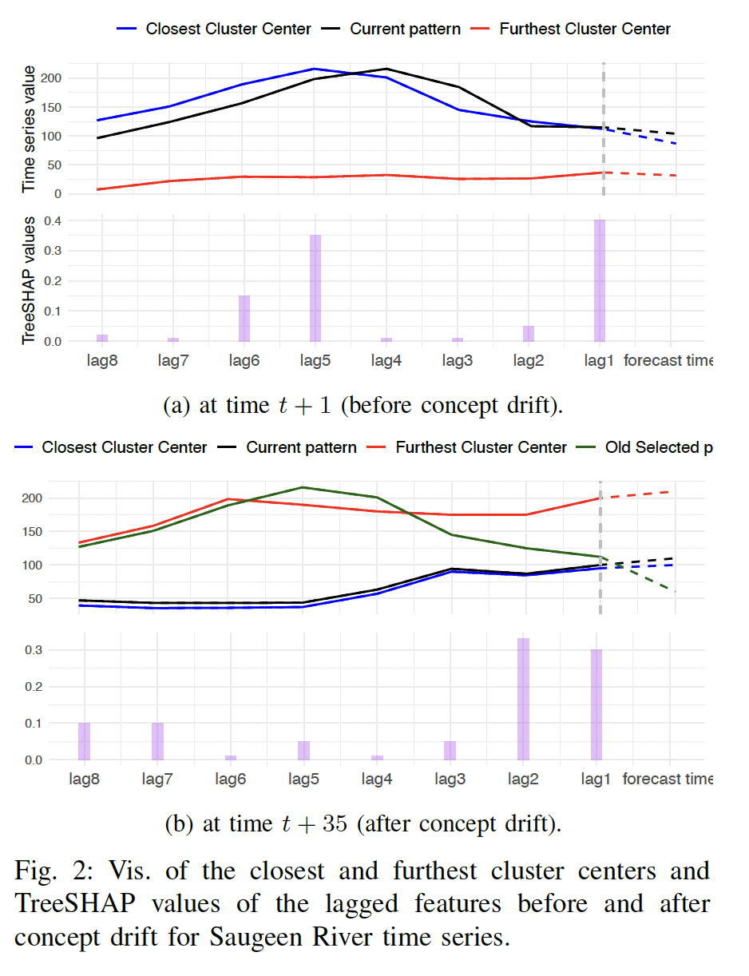
Experiments
Results
Notes:
Color Codes hier ergänzen

Slide 18
Concluding Remarks
OLITE: a novel, practically useful online tree ensembles for time series forecasting.
OLITE specializes individual trees across different input regions in the time series and uses a well-devised weighting schema for online ensemble aggregation.
OLITE is updated in an informed manner following concept drift detection in the time series.
An exhaustive empirical evaluation, including 1000 real-world datasets and multiple comparison algorithms, showed the advantages of OLITE in terms of performance and scalability.
Notes:
Color Codes hier ergänzen

