Slide 1
Surrogate Models for Water Distribution Networks
André Artelt
Lamarr Lab Visits 2025
Dortmund, 16/02/2025

Slide 2
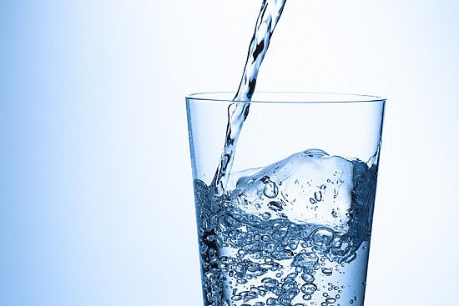
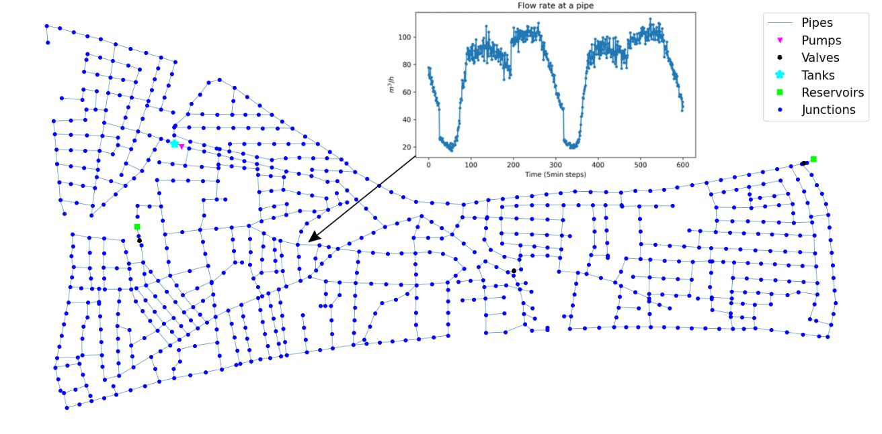
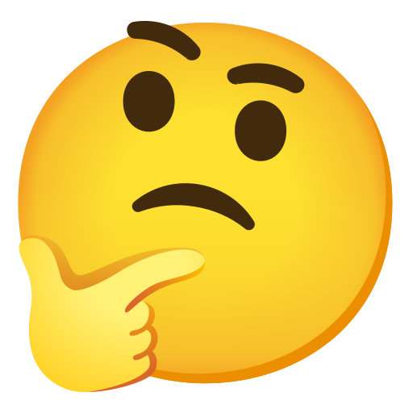
Water Distribution Networks (WDNs)
Networks for delivering drinking water to consumers
=> Critical Infrastructure
Complex (sparse) spatio-temporal signals
Changes in demand
Events (leakages, sensor faults, contaminations, ...)
Uncertainties
Tasks:
Control
Event diagnosis
Planning
…..

Slide 3
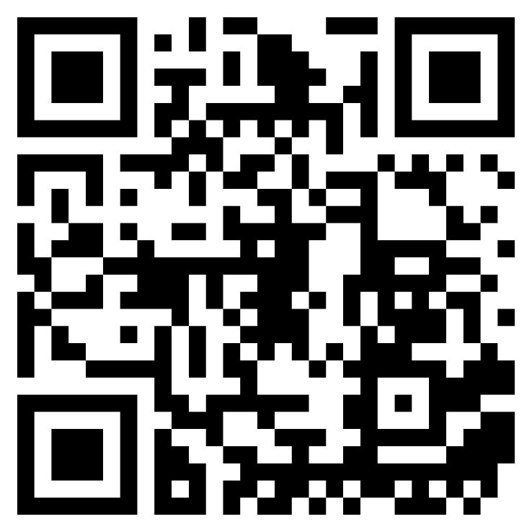
Modeling of Water Distribution Networks
Modeled as a graph
Dynamics:
Hydraulics
Chemicals (i.e. water quality)
Dynamics described by algebraic and (partial) differential equations
Simulation = Solving equations
Software such as EPANET-(MSX)
EPyT-Flow
….

Slide 4
Need of Surrogate Models
Solvers are
Slow
Not differentiable
Neural Surrogates could enhance:
Planning
(Model-based) Control
Sensitivity analysis (e.g. sensor placements)
Challenges:
Complex dynamics
Long time horizons
Tanks, pumps, valves
Uncertainties
Critical domain => Trustworthiness?

Slide 5
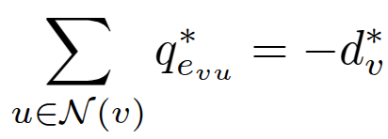
Hydraulic Dynamics in WDNs
Key quantities:
Flow
Pressure (Head)
Demand
Demand => Pressure & Flow
Physics
Steady-state (assumption)
Conversation of flows
Conversation of energy

Slide 6
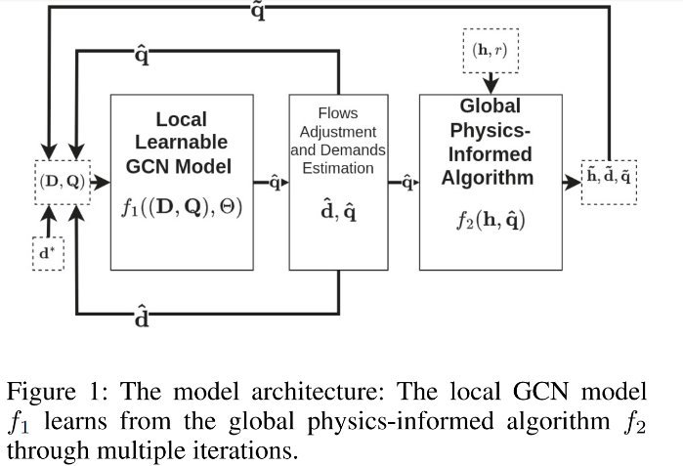
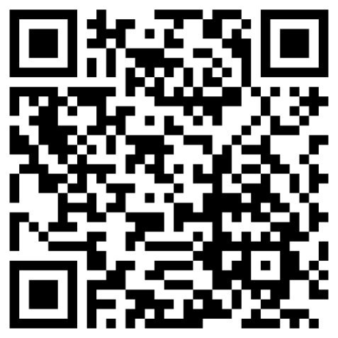
Surrogate for Hydraulic Dynamics
Given a WDN graph
Map demands to flows and pressures
Iterative Approach:
Estimate flows
Reconstruct demands
Estimate heads, demands, flows in physics-informed message passing Algo.
=> Converges to fix point!
Ashraf et al. 2024; Ashraf & Artelt et al. 2025

Slide 7
Water Quality Dynamics
Key quantity
Chemical concentrations
Challenge: Different chemicals & reactions
=> Lots of uncertainties!
=> No steady-state
Physics:
Flow => Concentrations
Transport, Mixing, and reactions
Current work:
Benchmarks
GNN for advective transport

Slide 8
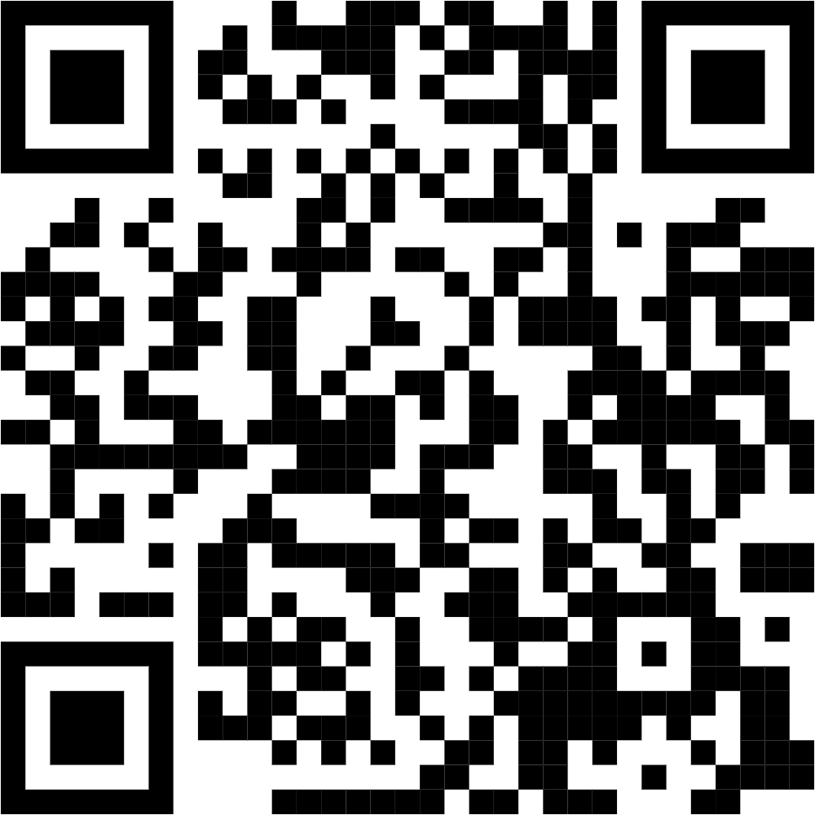
Summary
Water Distribution Networks
Graphs
Complex dynamics
Challenges
Sparse spatio-temporal signals
Uncertainties
Hydraulics Surrogates
Water Quality Surrogates
Software packages on GitHub

