Slide 1
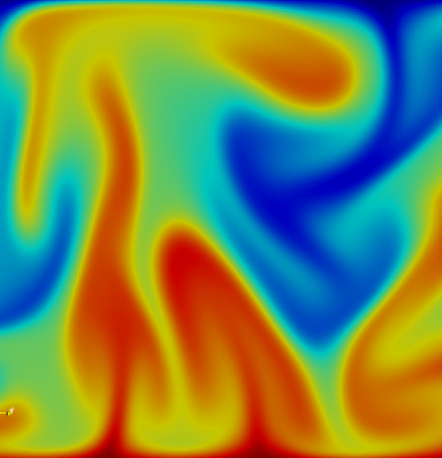
Physics-Informed Machine Learning
Brief Introduction to PINNs
Thorben Markmann
Bielefeld University
Lamarr Lab Visits
18.02.2025

Slide 2
Physics-Informed Machine Learning
Stages of Machine Learning:
Problem Formulation
(What do we want to model?)
Data
(Collection, Preprocessing, Coordinate System, …)
Architecture Design
(NN, RNN, Autoencoder, DMD, NO)
Loss Function
(What models are good?)
Optimization
(Which algorithm to optimize the model?)
Physics-Informed Machine Learning
Embed physical knowledge in techniques from ML
we already have insights from hundreds of years of physics
solve complex tasks
constrain model to lower cost and learn from small data
Embed Physics Knowledge
PINN

Slide 3
Physics-Informed Neural Network (PINN)
Definition: PINNs are neural networks that incorporate physical knowledge (e.g. differential equations) as part of their learning process.
How They Work:
Instead of training only on data, PINNs minimize the residual of governing equations
Loss function includes physics constraints:
$$L=L_{data}+L_{physics}$$
Key Advantage: PINNs generalize well even with limited data
Raissi et al. 2019

Slide 4
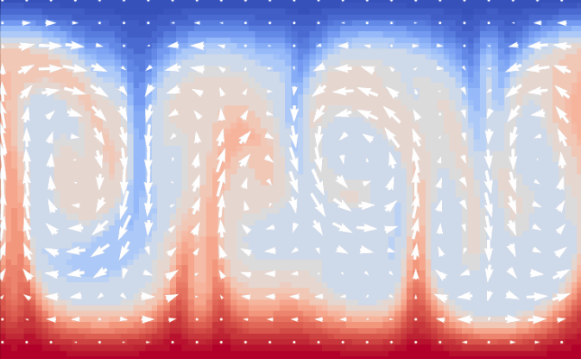
Physics-Informed Neural Network (PINN)
naive approach to predict physics
predict field variables for spatiotemporal coordinates
$$L_{data}=\sum{{\left\|\hat{u}\left(x_{j}\right)−u\left(x_{j}\right)\right\|}_{2}^{2} }$$
Raissi et al. 2019

Slide 5
Physics-Informed Neural Network (PINN)
PINN approach
Raissi et al. 2019

Slide 6
Physics-Informed Neural Network (PINN)
PINN approach
physics-informed
train PINN on:
“real” data
virtual data via sampling
→ offload training to virtual points if you have small amount of data
via Autodiff
$$L_{pde}=\sum{{\left\|𝒩(u(x_{j}),x_{j},t)\right\|}_{2}^{2} }$$
$$∇∙u=0$$
$$\frac{∂u}{∂t}+\left(u∙∇\right)u=−∇p+\frac{1}{Re}∇^{2}u$$
PDE
Raissi et al. 2019

Slide 7
Physics-Informed Neural Network (PINN)
Advantages & Challenges
Advantages:
Works well with sparse data
No need for extensive simulation data
mesh independent
Challenges:
Training can be slow
Optimization is difficult
Choice of nn architecture and hyperparams
only physical plausible without hard constraints

Slide 8
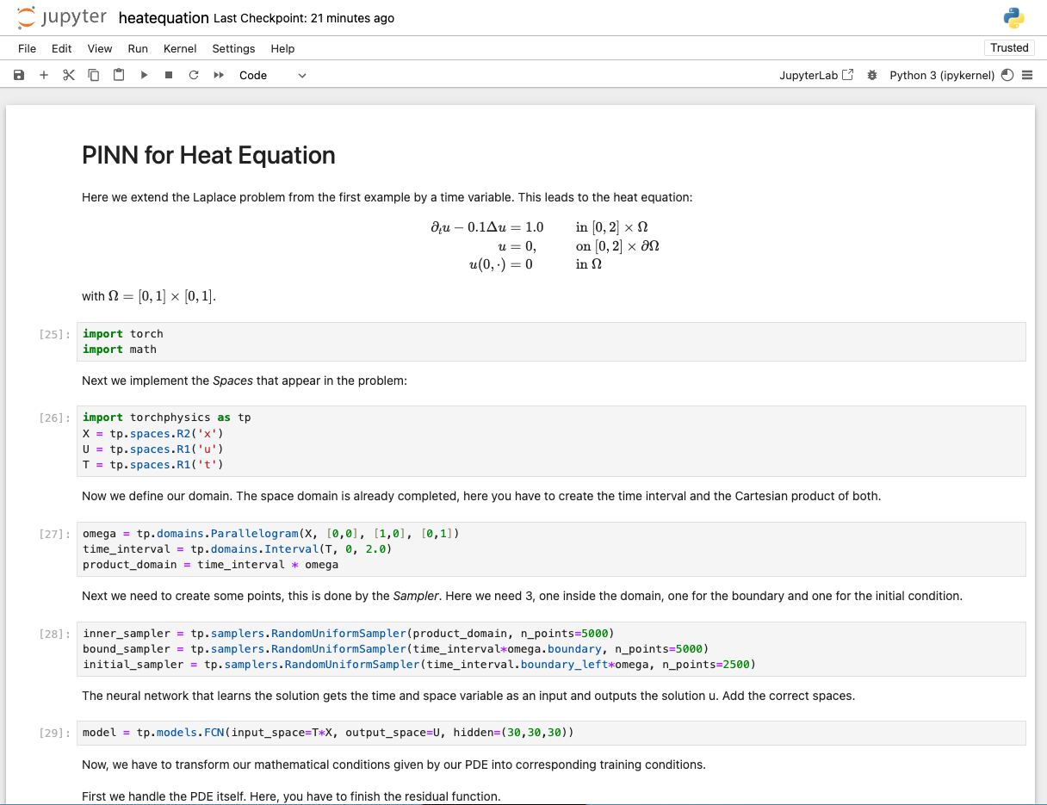
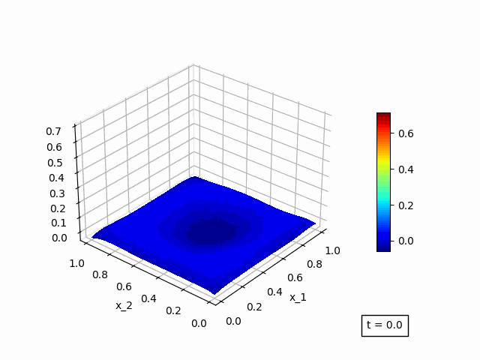
Physics-Informed Neural Network (PINN)
Example
TorchPhysics example on Heat Equation
github.com/boschresearch/torchphysics

Slide 9
PINNs for Forced Dynamics
Future Work
Physics-Informed Surrogate Models for Rayleigh–Bénard Convection
compare to prior surrogate models
Model-Based Reinforcement Learning
PINN with control term
physics-informed neural operator (pino)
Rayleigh–Bénard Convection
Rayleigh–Bénard Convection
with control

Slide 10
Further Resources
Paper
M. Raissi, P. Perdikaris, and G. E. Karniadakis, “Physics-informed neural networks: A deep learning framework for solving forward and inverse problems involving nonlinear partial differential equations” 2019
Z. Li et al., “Physics-Informed Neural Operator for Learning Partial Differential Equations,” 2023
S. Cuomo, V. S. di Cola, F. Giampaolo, G. Rozza, M. Raissi, and F. Piccialli, “Scientific Machine Learning through Physics-Informed Neural Networks: Where we are and What’s next,” 2022
Z. Hao et al., “Physics-Informed Machine Learning: A Survey on Problems, Methods and Applications,” 2023
Frameworks
TorchPhysics
NVIDIA modulus
Lecture Series on YouTube by Steve Brunton

Slide 11
Thorben Markmann
Bielefeld University
tmarkmann@techfak.uni-bielefeld.de

