Slide 1
Introduction to Indico
Lamarr’s Management Tool for Meetings, Events, Workshops and Conferences
Dr. Jens Buß

Slide 2
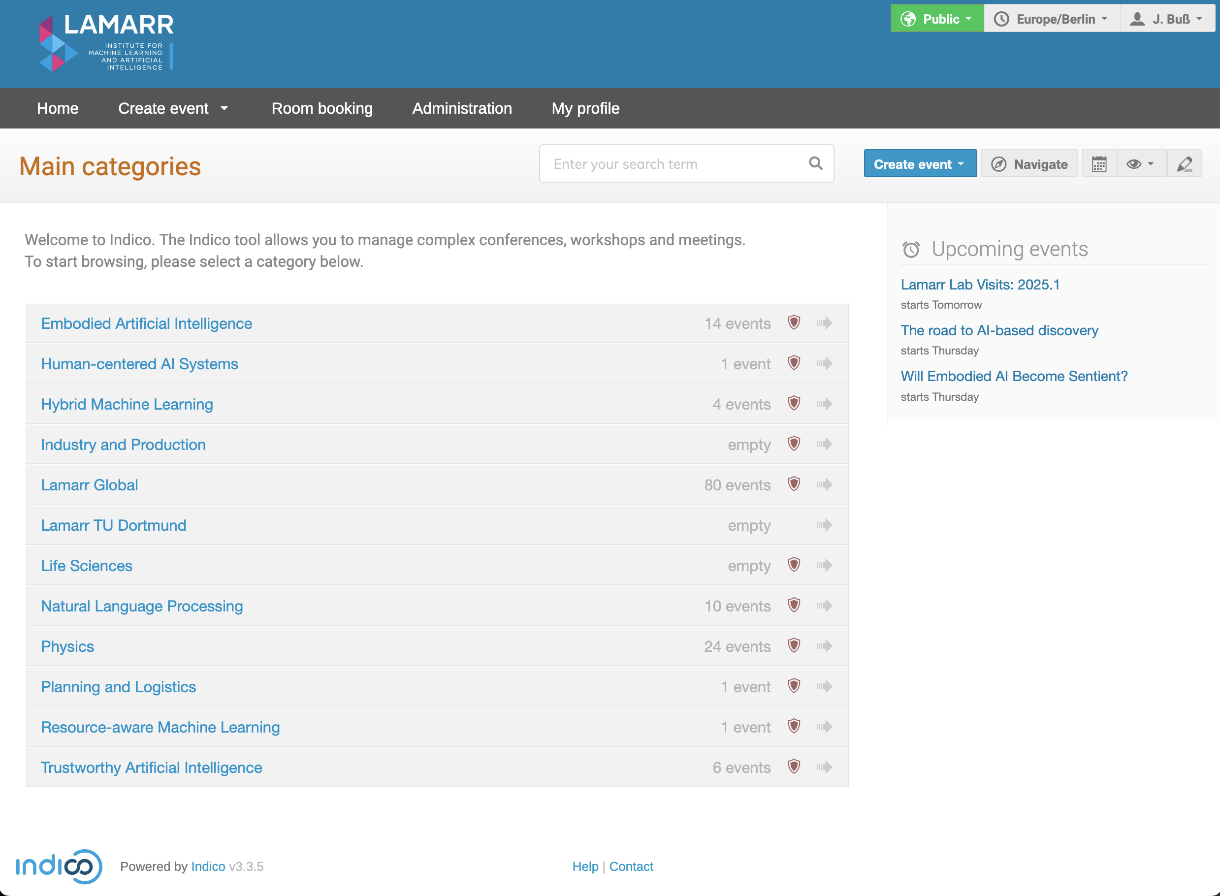
Introduction
What is Indico?
Indico (Integrated Digital Conferencing)
Web application for the organization of events of all sizes
Ranging from meetings and lectures to big conferences.
Open Source Software developed at CERN
Wide feature set
Event landing page with schedule and registration
Reviewing workflows for scientific papers and abstracts
Room booking system
Central Archive
Documentation: https://learn.getindico.io/
Since March 2024 we run an instance of Indico as service to for event management

Slide 3
Nomenclature and Central Terms
Further central Terms in Indico
Event
Main structure in Indico, representing a meeting, workshop, or conference.
Category
Grouping events or other Categories together
Contribution
A presentation, talk, or other content submitted by participants (e.g. within a session).
Sub-Contribution
A smaller unit within a contribution, useful for multi-part presentations.
Session
Grouping related contributions when creating a timetable.
Example: A conference split into
A welcome session
A session dedicated to talks
Several parallel workshop sessions
Session Block
A scheduled part of a session, defining its exact time and location.

Slide 4
Event Types
Definition of event types and features
Common features
Registration
Management of participants
Surveys
Material upload (e.g. Slides)
Integration with collaborative tools
Event reminders
Calendar export
Lecture
single presentation, with one or more speakers
Key Features:
Event description or abstract
Speaker(s)‘ names
May re-occur over several days
No Time Table!
Meeting
(Generally) composed of many presentations.
Key Features:
Timetable
Minutes
can last multiple days (mostly single day)
Contributions (talks) organized in sessions
Conference
(Generally) multiple days and allowing multiple sessions in parallel. Key Features:
Programme definition
Sessions
Call for abstracts
Abstract submission,
E-payment facilities
Publication Review.
No Minutes!

Slide 5
Example: Lecture
Creating a Lecture
Filling the Basic information
Adding Material
Settings
Protection
Privacy
Participants
Reminders

Slide 6
Example: Meeting
Creating a Meeting
Defining a Chair Person
Timetable
Contributions and Sub contributions
Minutes
Features Available to Chairpersons in Indico:
Access to Session Management Tools – Ability to manage session content and speaker information.
Timetable Control – Adjust session and contribution timings.
Contribution Oversight – View and manage presentations and abstracts within the session.
Participant Interaction – Monitor and engage with attendees during the session

Slide 7
Example Conference
Creating a Conference
Settings
Defining the Programm
Creating Sessions
Time Table
Contributions
Registrations
PC Roles
Custom Roles

Slide 8
More Features
Surveys
Email Service
Reminders
Logs
Room Booking
Layout
Nametags and Posters
Document Templates

Slide 9
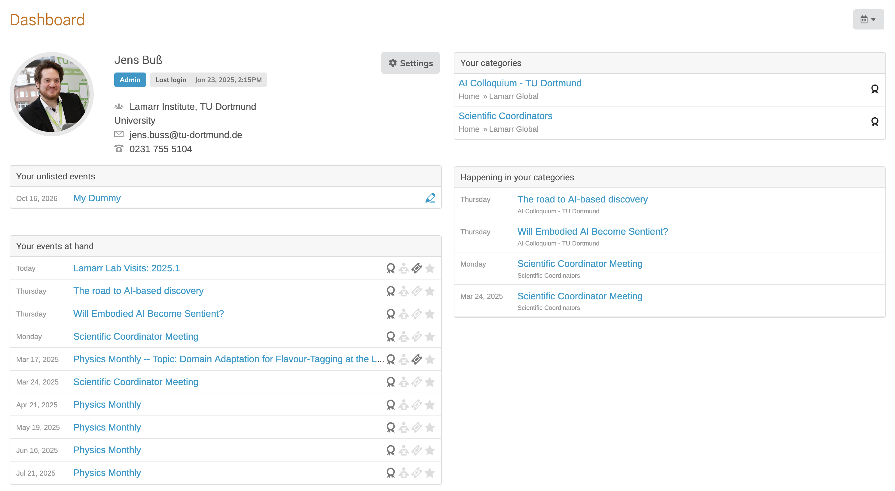
My Profile

