Slide 1
Lab Visits 2026.1
Organizational Information
Dr. Jens Buß

Slide 2
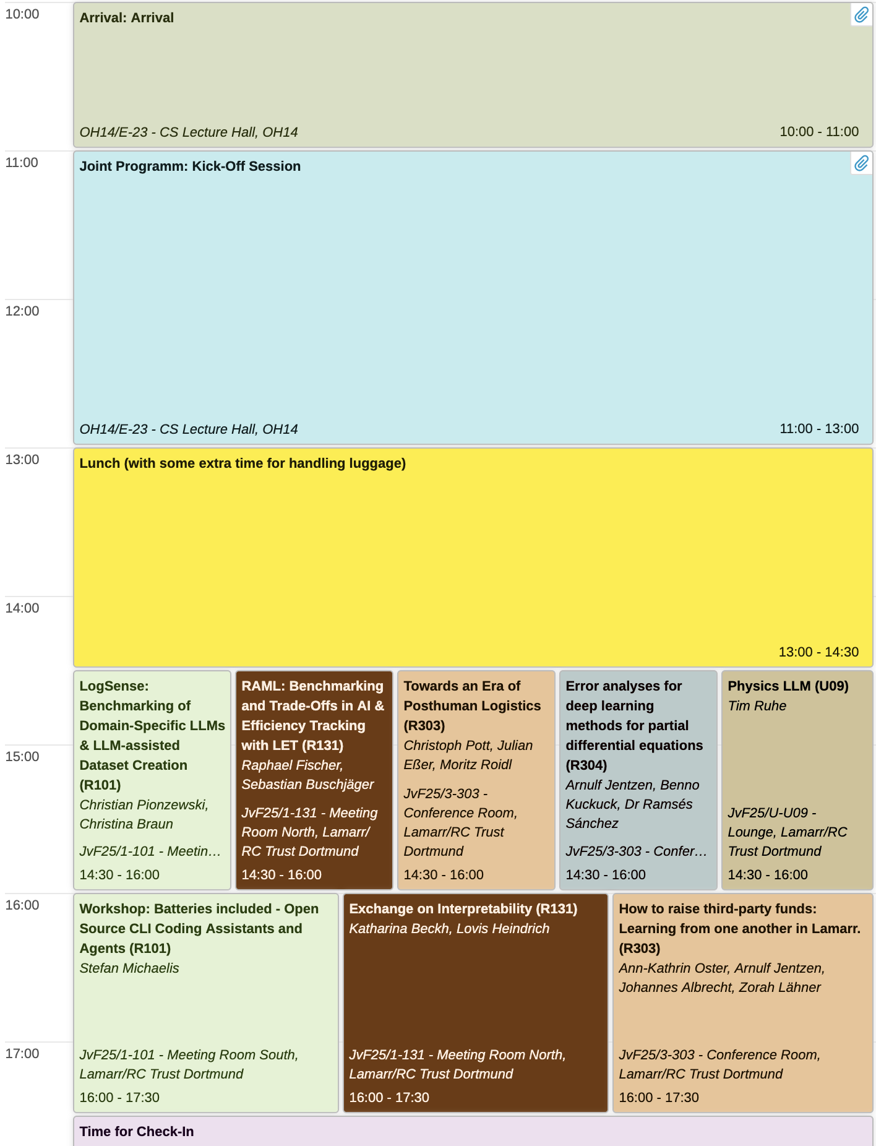
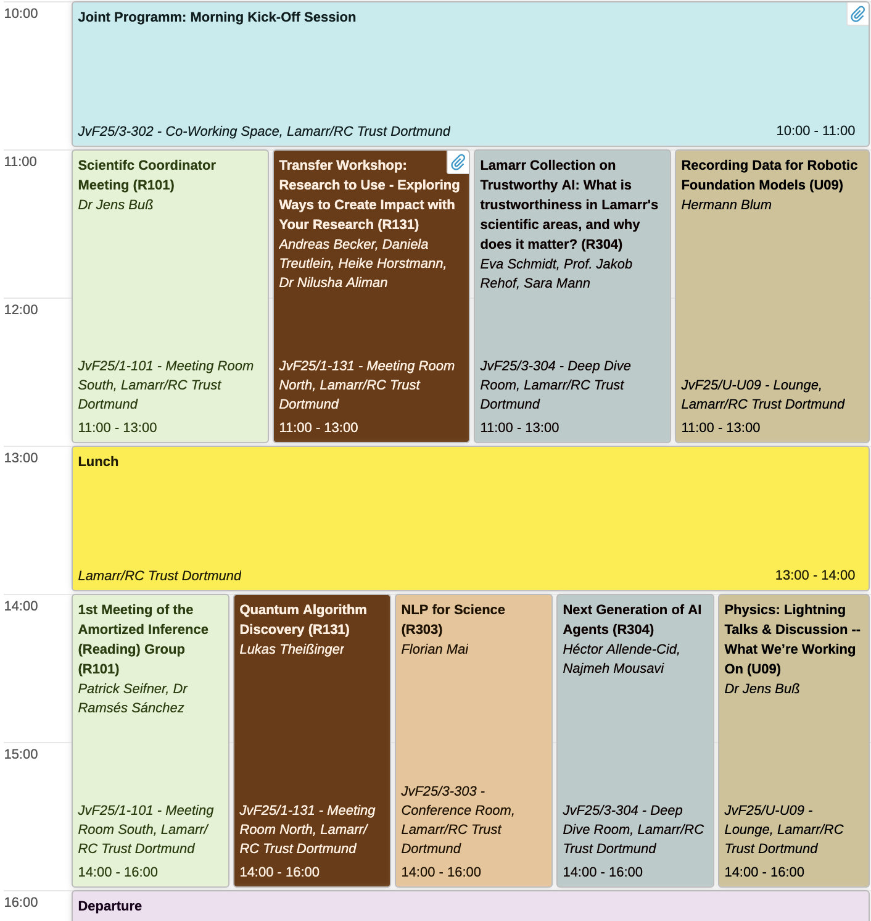
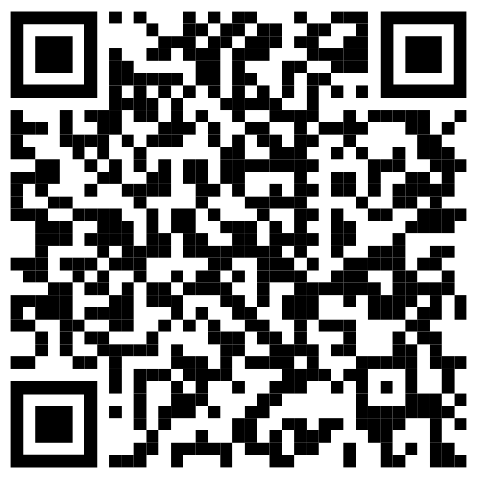
Program on Indico
Location: Lamarr Institute
All information on Indico:
Sessions
Times
Locations
Conveners
Questions: Ask the people with the red name tags for help !
Or call Jens: +49 231 755 5104
Area Updates II
Session pitches
Welcome
Area Updates I
Science Speed dating
Session pitches
https://events.lamarr-institute.org/e/lab-visits-2026-1

Slide 3

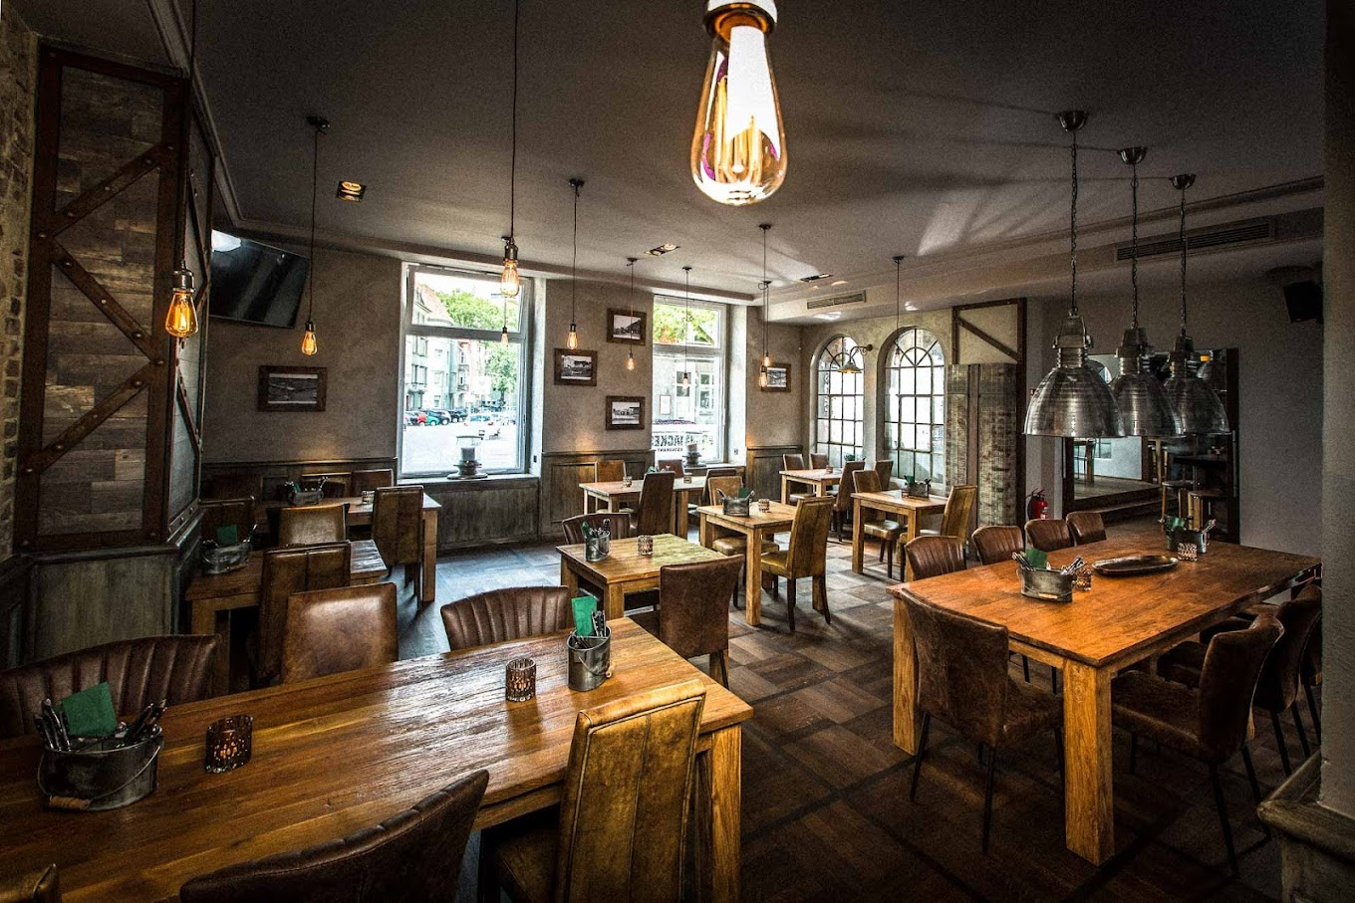
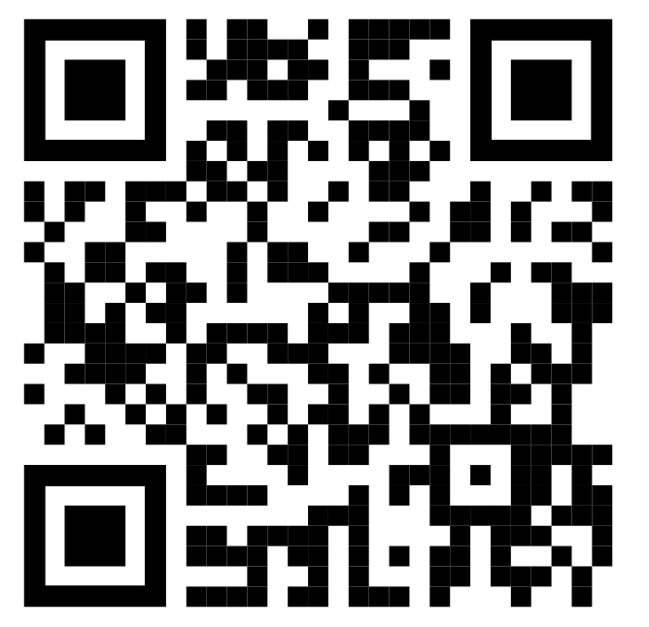
Social Dinner
Good Food. Great Company. Even Better Connections.
Tonight at 7 PM
Hohe Str. 61A
44139 Dortmund

Slide 4
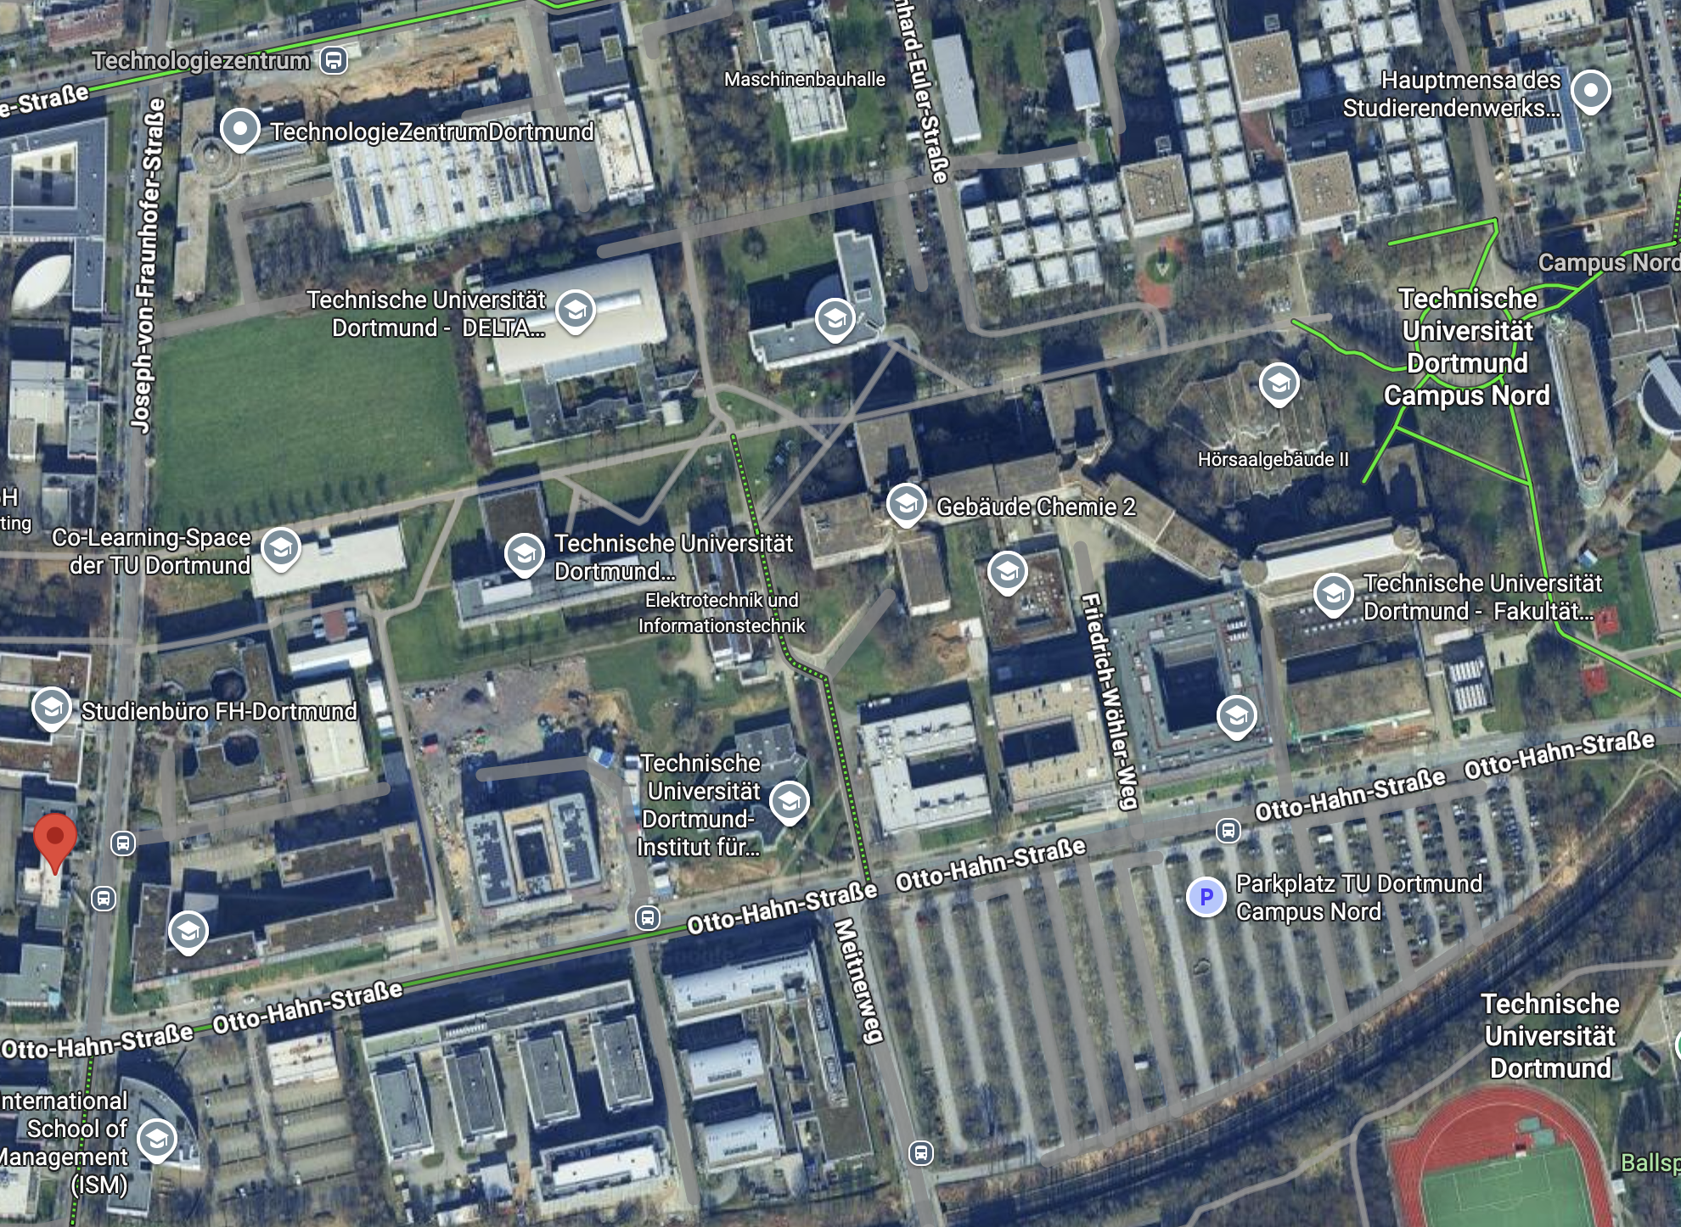
Directions to the Lamarr Institute
Mensa
After lunch we will continue in the Lamarr Institute
You are here

Slide 5
Location and Rooms
What to find where at the Lab Visits
Notes:
Hinweis auf Arbeiitsräume

Slide 6
Location and Rooms
What to find where at the Lab Visits
Check Indico and room plans in the stairways for sessions and locations
Notes:
Hinweis auf Arbeiitsräume

Slide 7
Location and Rooms
What to find where at the Lab Visits
Check Indico and room plans in the stairways for sessions and locations
No meeting rooms on 2nd floor
Notes:
Hinweis auf Arbeiitsräume

Slide 8
Location and Rooms
What to find where at the Lab Visits
Check Indico and room plans in the stairways for sessions and locations
No meeting rooms on 2nd floor
Additional meeting room in the basement (Lounge)
Notes:
Hinweis auf Arbeiitsräume

Slide 9
Location and Rooms
What to find where at the Lab Visits
Working spaces: 1st & 2nd floor
For spontaneous:
solo work
small groups
Rooms are not locked !
Notes:
Hinweis auf Arbeiitsräume

Slide 10
Location and Rooms
What to find where at the Lab Visits
Coffee & tea
Cookies & fruit
Mingle & Chat
Tuesday Morning Kick-off
Notes:
Hinweis auf Arbeiitsräume

Slide 11
Location and Rooms
What to find where at the Lab Visits
Room will be locked
Ask the people with the red name tags for help !
Room will be open after group photo
Bring after the group photo!
Luggage
Notes:
Hinweis auf Arbeiitsräume

Slide 12
Location and Rooms
What to find where at the Lab Visits
Room will be locked
Ask the people with the red name tags for help !
Room will be open after group photo
Bring after the group photo!
Luggage
Questions ???
Notes:
Hinweis auf Arbeiitsräume

Slide 13
Directions to the Lamarr Institute
Mensa
After lunch we will continue in the Lamarr Institute
You are here
ISM Mensa

Slide 14
Lunch: Mensa Locations
Mensa
You are here
ISM Mensa

Slide 15
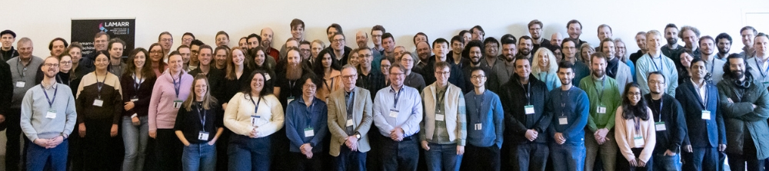
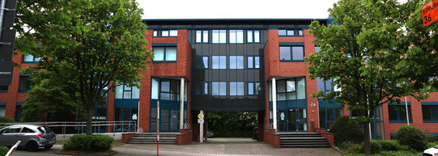
Group Photo: Simple Instructions
Mensa
1. Go here !
You are here
2. Do this !!
3. In front of this !!!
Go to luggage room after the group photo!
ISM Mensa

